Slide 1
EmpowHer
EmpowHER: Empowering Girls for Corporate Excellence
The Role of the Production Support Team

Slide 2
Agenda
Introduction
What is Production Support?
Roles & Responsibilities of the Production Support Team
Aps Team -> Additional Activities
Key engagements for APS team
Incident Management
Production Support Team Engagements.
Skills Required in the Production Support Team
Conclusion

Slide 3
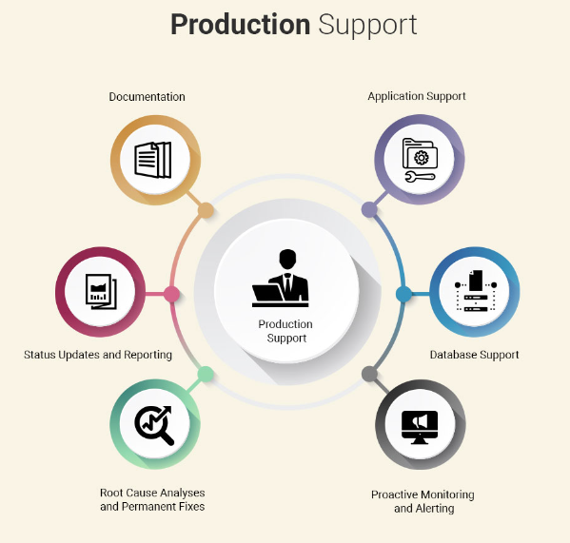
Introduction
Production support covers the practices and disciplines of supporting the IT systems/applications which are currently being used by the end users.

Slide 4
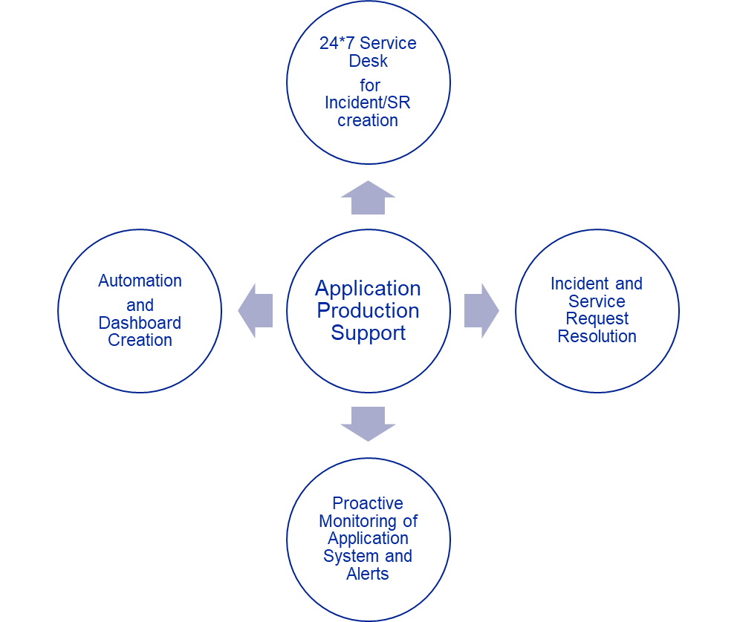
What is Production Support?
Production support as the name says is about Supporting the production environment of the company.
Production support involves working closely with business stakeholders (such as traders) to resolve any issues with technical systems and applications.
In a trading environment, traders will typically raise 'tickets' – requests for help – with the support teams, usually over e-mail or by telephone. Those tickets will enter a queue of work where the progress of investigations can be tracked.
The Production Support team pick up those tickets and work to address the issues, liaising with other technical teams where necessary.

Slide 5
Roles & Responsibilities of the Production Support Team
L1:
Incident Management:
Resolve Incidents and requests with the help of SOP’s.
Acknowledge & Resolve Incidents.
Periodically review and decrease the MTTR
Prioritize the incidents based upon severity.
Escalate and engage L2/Dev in case unable to resolve.
Knowledge on Monitoring tools like Splunk, AppDynamics.
Email alerts monitor and handling.
Daily review of ServiceNow/Tableau dashboards.
Regular connect and scrum call with respective function lead.
Weekend Sanity Support – Adhoc and scheduled.
L2:
SME level knowledge of Business applications:
Have the architecture level knowledge.
Have dev contacts and servers/DB level details.
Well equipped with log analysis.
Periodic review of Infra, ControlM, DB, AppDynamics, Splunk alerts.
Have knowledge to debug and to carry out RCA.
Triage critical business outages with the help of various stakeholders and communicate with dev, infra and Senior Management.
Develop SOPs or KB for recurring incidents or SRs
Problem management
Incident Management (extension of L1 support)
Sync with Change and Infra team for weekend changes and prioritize sanity and impact
Regular review of ServiceNow/Tableau dashboards

Slide 6
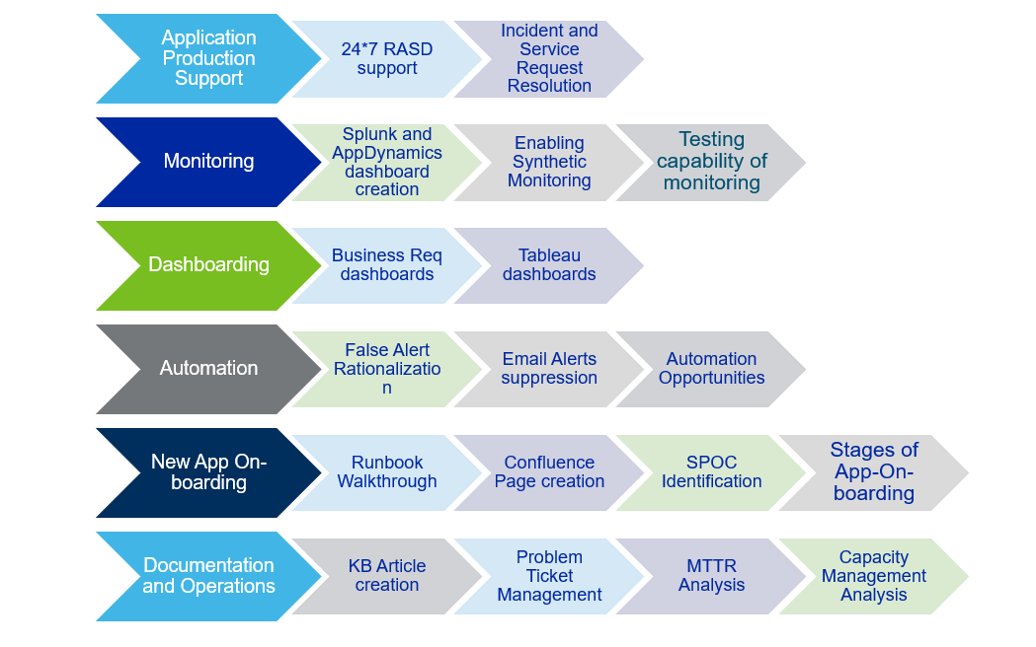
APS TEAM -> ADDITIONAL ACTIVITIES

Slide 7
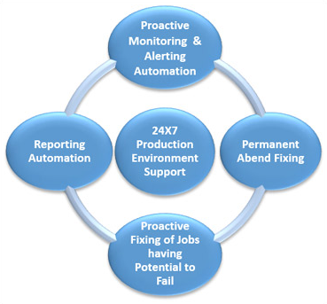
Key engagements for APS team
Incident management
Problem management
Change management
Release and deployment management

Slide 8
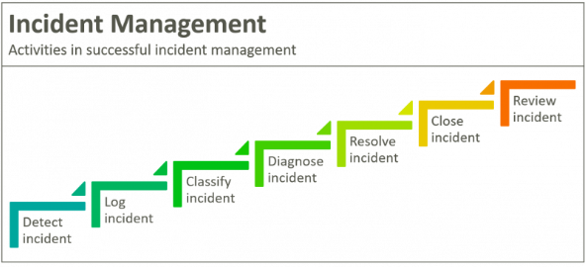
Incident Management
Incident management is the process of managing IT service disruptions and restoring services within agreed service level agreements (SLAs). The scope of incident management starts with an end user reporting an issue and ends with a service desk team member resolving that issue.
There are five steps in an incident management plan:
Incident identification.
Incident categorization.
Incident prioritization.
Incident response.
Incident closure.

Slide 9
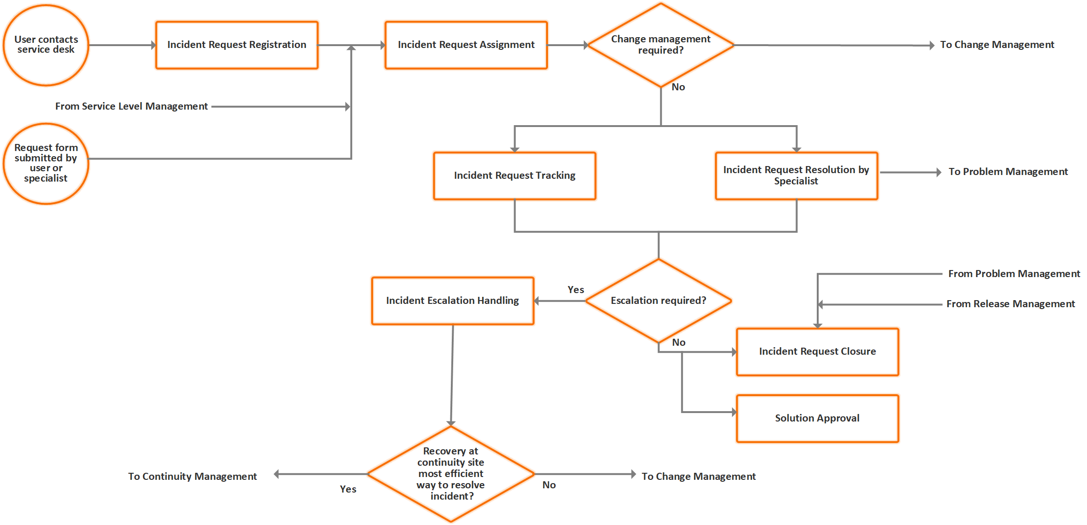
INCIDENT PROCESS:

Slide 10
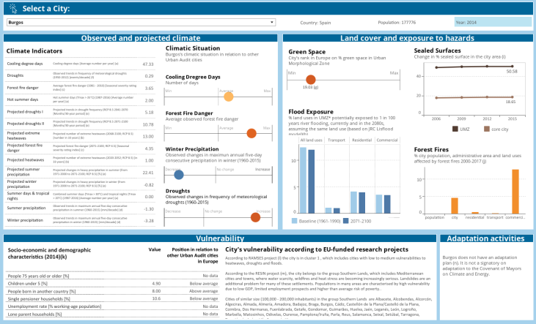
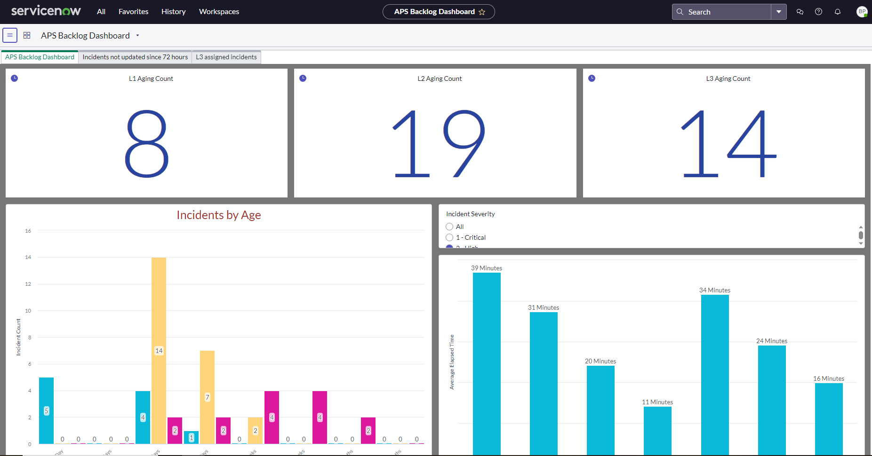
PRODUCTION SUPPORT TEAM ENGAGEMENTS:
Creating Dashboards:

Slide 11
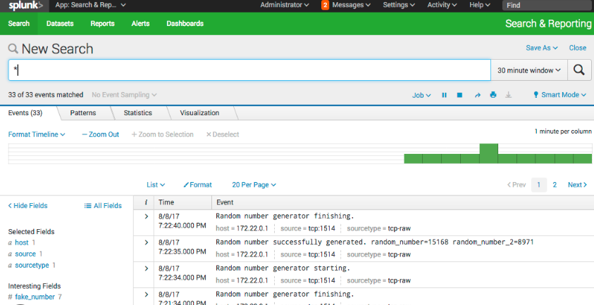
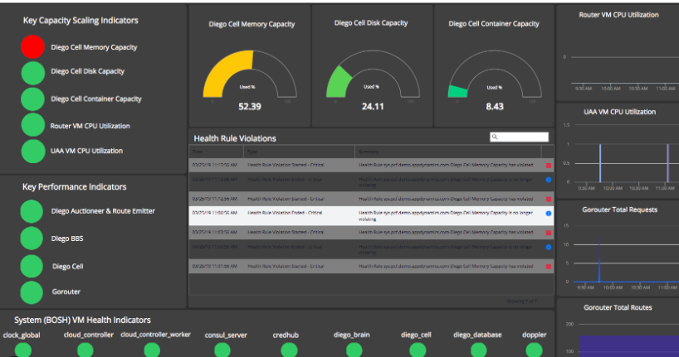
PRODUCTION SUPPORT TEAM ENGAGEMENTS: (contd)..
Working with alerts and creating dashboards through various monitoring tools like Splunk, AppDynamics. etc.

Slide 12

PRODUCTION SUPPORT TEAM ENGAGEMENTS: (contd)..
Production Support team also helps an organization with automation ideas and creates automation for various mundane works or repetitive works. Like the following works the team supports:
Incident Automation.
Routine Tasks Automation.
Deployment Automation.
Auto-Healing Mechanisms.
Automated Alerts and Notifications.
Automated Documentation.
Scripting and Coding.

Slide 13
Skills Required in the Production Support Team
Try to be good in any Database with OS knowledge:
ex : ORACLE + UNIX/LINUX , .NET +windows
Get an idea about ITIL process:
( incident management, Problem management, Change Management) and LEAN processes ,SLA’s
Learn any ticketing tool:
ServiceNow
BMC remedy impact tool
HPSM
Learn any scheduling tool:
Control-M
Autosys
ESP
Get idea about monitoring tools
APM
SPLUNK
OPNET

Slide 14
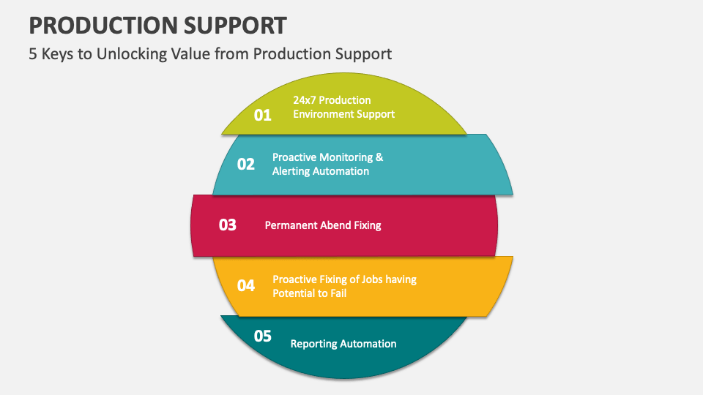
Conclusion

Slide 15

THANK YOU

Slide 16
Appendix
Add Links or permissible Images as needed

